Slide 1
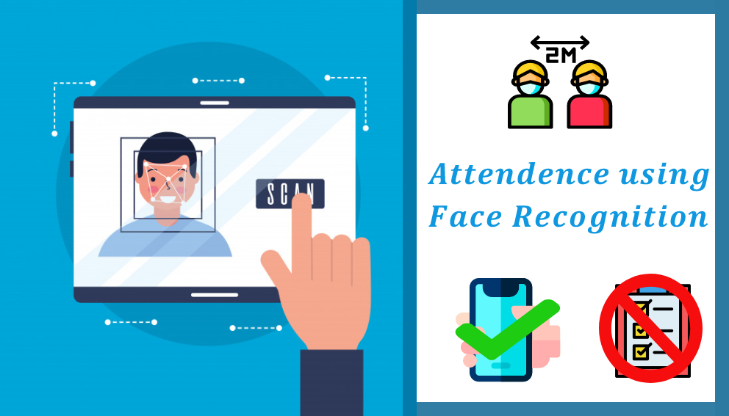

Slide 2
What Inspired Us
What have we Created
1
2
Table of Contents
3
4
Components Used
Our Goals
4
3
Our Success
Statistics
5
6
Findings
7

Slide 3

What inspired us
Missing attendance call during class due to barriers like sitting far from the teacher’s table.
The paper wasted recording the attendance.
The students not knowing whether he/she has been marked present or not.
Time wasted in recording the attendance manually.
Also a special problem which arrived due the current situation i.e. everyone should wear a mask for his as well as the safety of others.

Slide 4
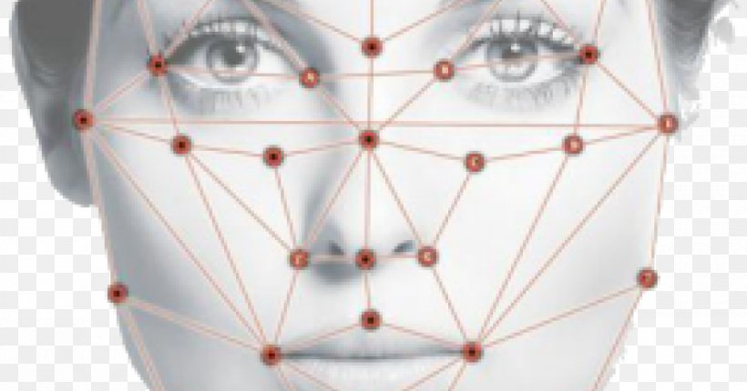
Attendify
“That’s what we call it”
We have developed a real time software which uses facial recognition to scan the face of the user and if the user is present in the database then his attendance is recorded which can be viewed by the user anytime.
It also generates an alert when the user scanning the face is not wearing a mask.

Slide 5

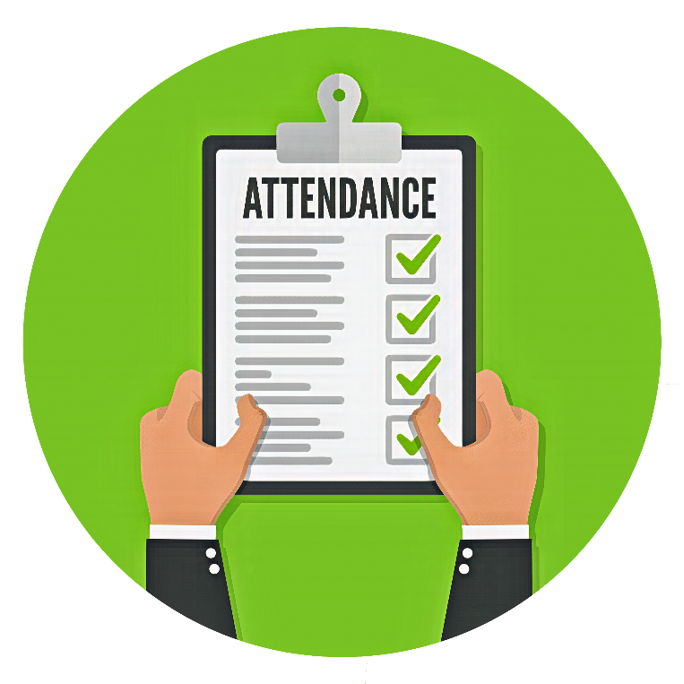

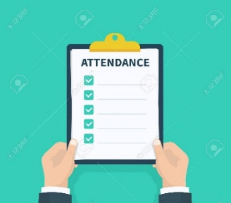
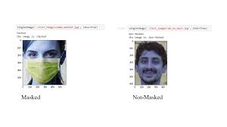
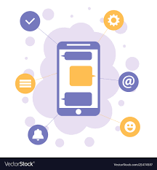

What have we Created
Facial Recognition
Attendance Marking System
Mask Detection Module
Mobile App
Mobile Alerts

Slide 6

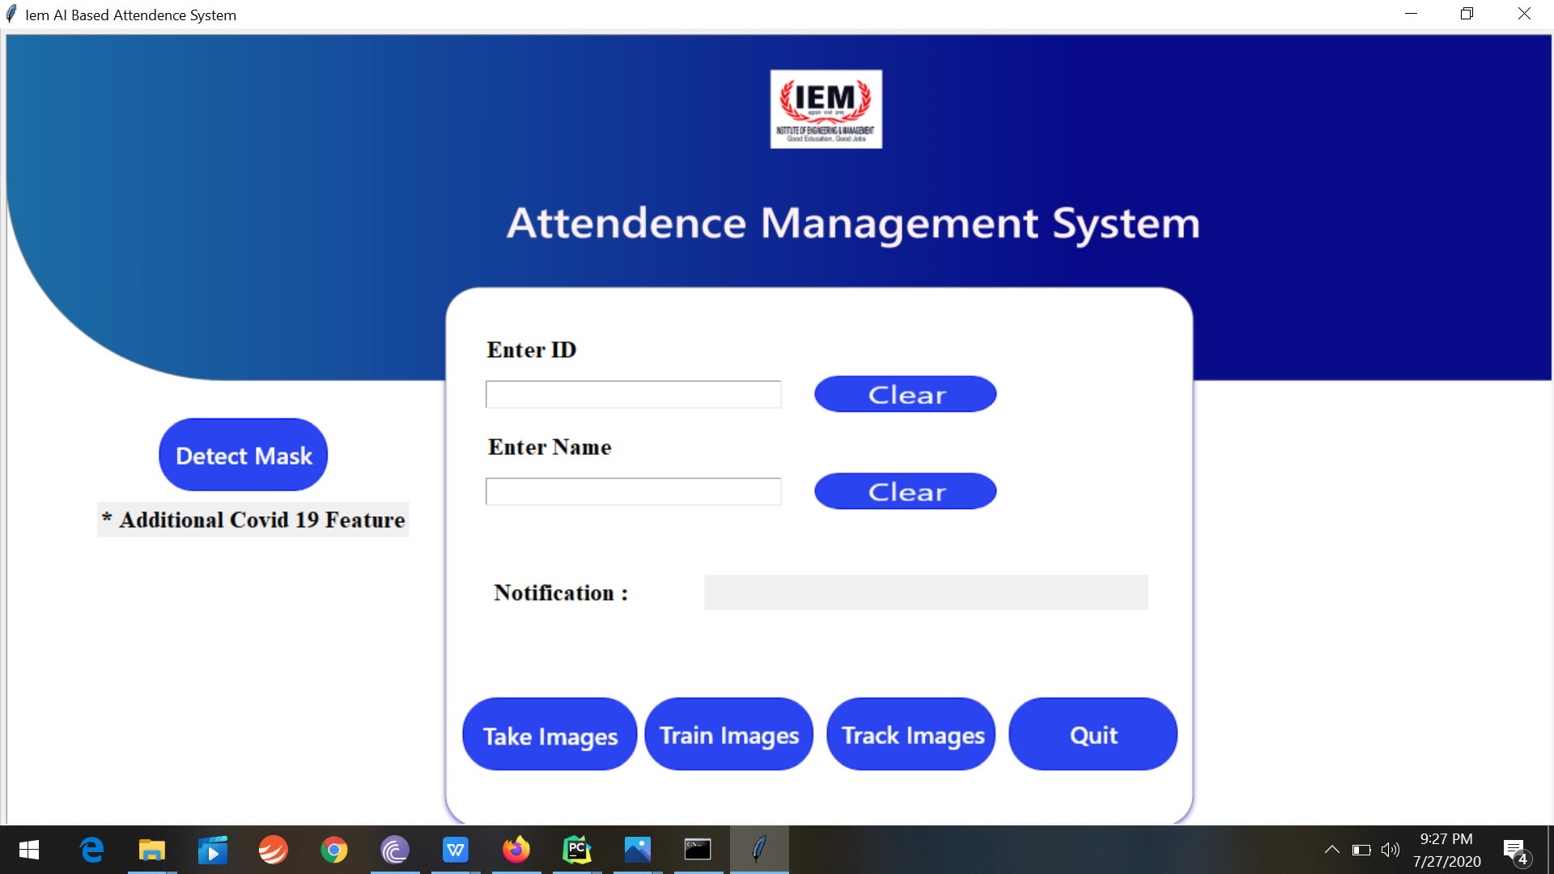
Enter the Student ID
Enter the Student Name
A special feature that checks the person recording the attendance is wearing the mask or not
This is to quit the application
This will take 60 images of the user
This will train the module and generate a yml file
This button will record the attendance

Slide 7
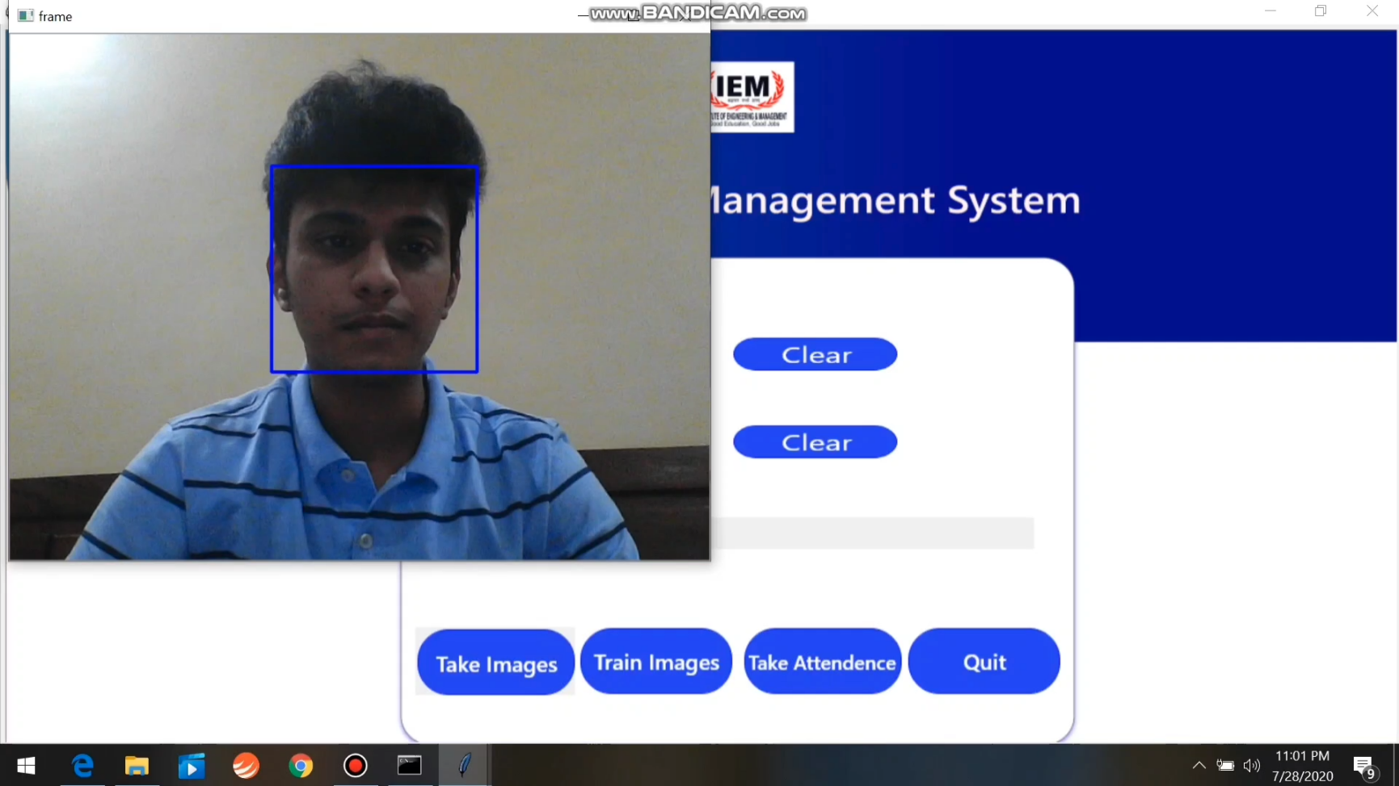
Take Image Module
The take image button fires up a function which opens the webcam of the laptop and take 60 images of the student.

Slide 8
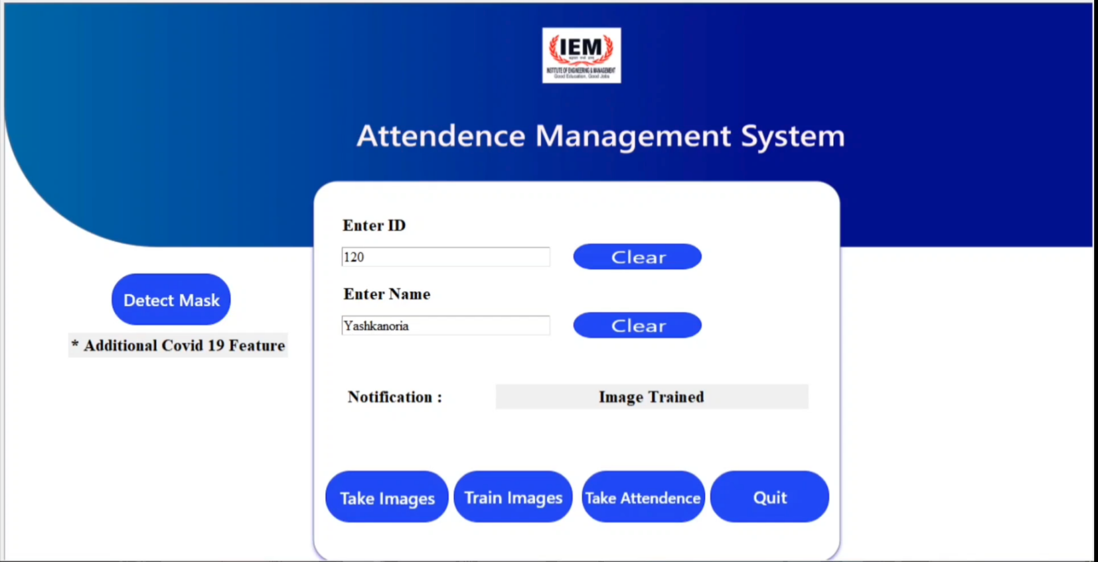
Train Image Module
The train image button fires up a function which creates a yml file

Slide 9
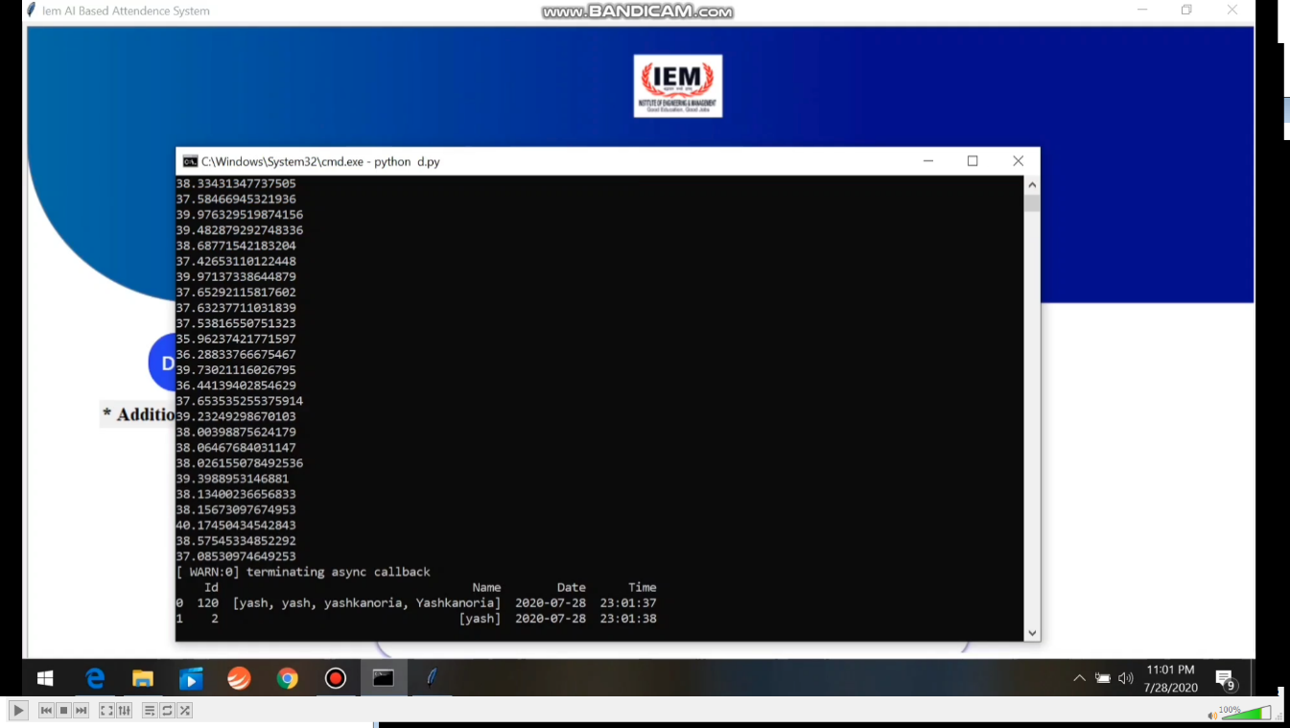
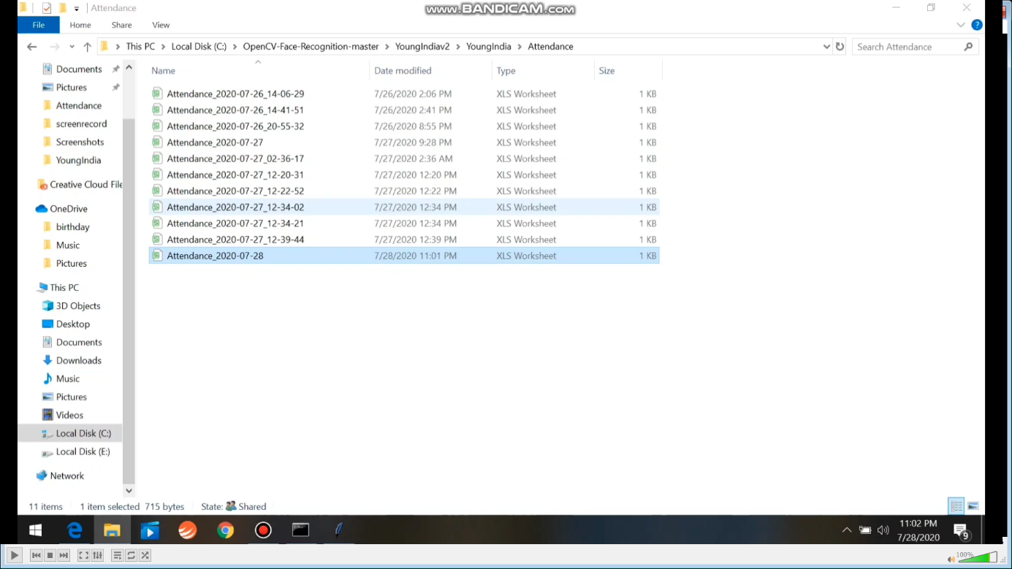
Take Attendance Module
The attendance is recorded in an excel sheet every day as well as printed in the terminal

Slide 10
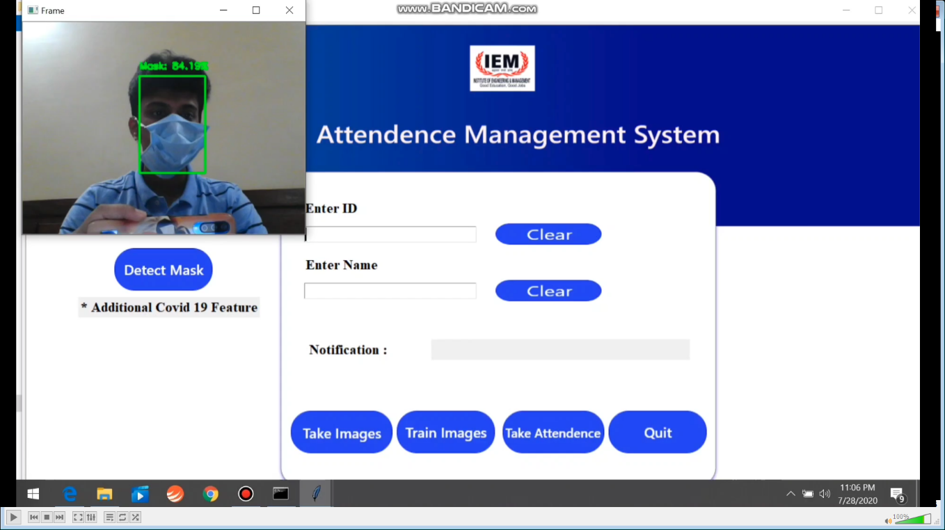
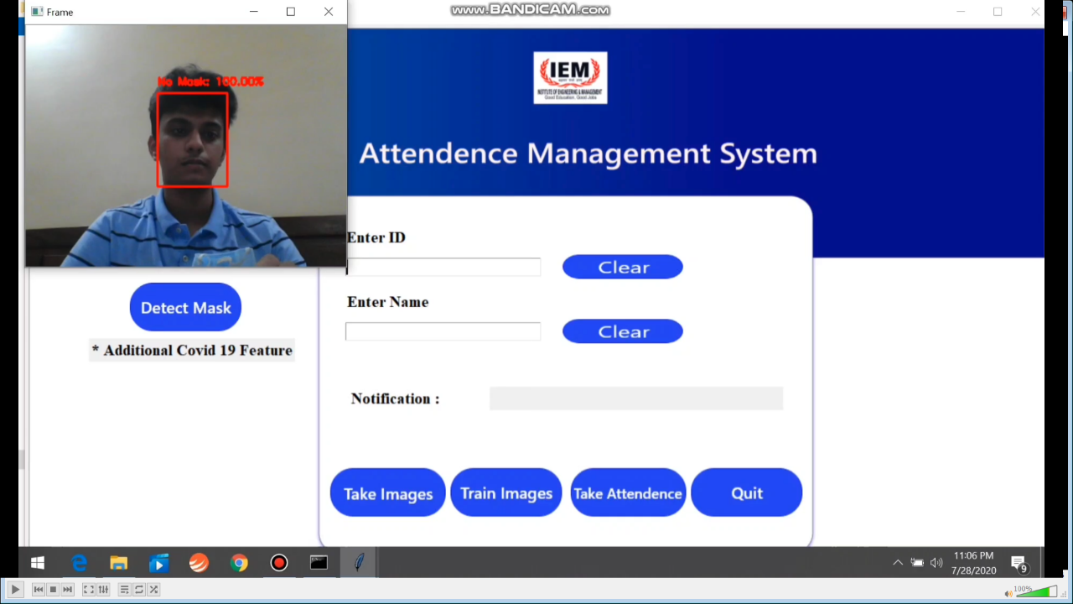
Special Mask Detection feature
A special COVID-19 feature which we included is that a module that checks whether the user recording the attendance is wearing a mask or not.

Slide 11
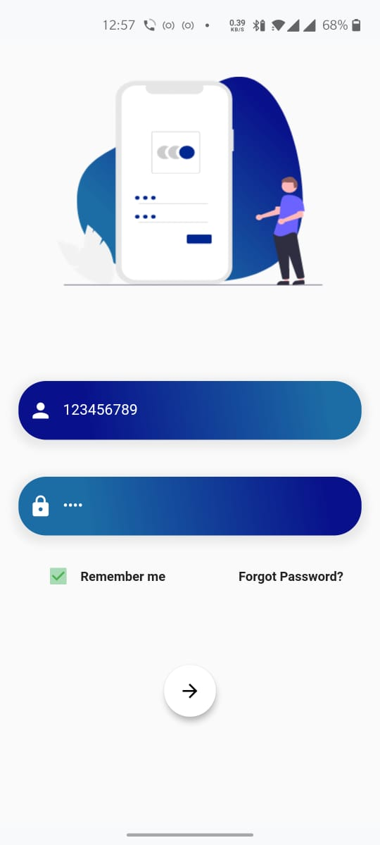
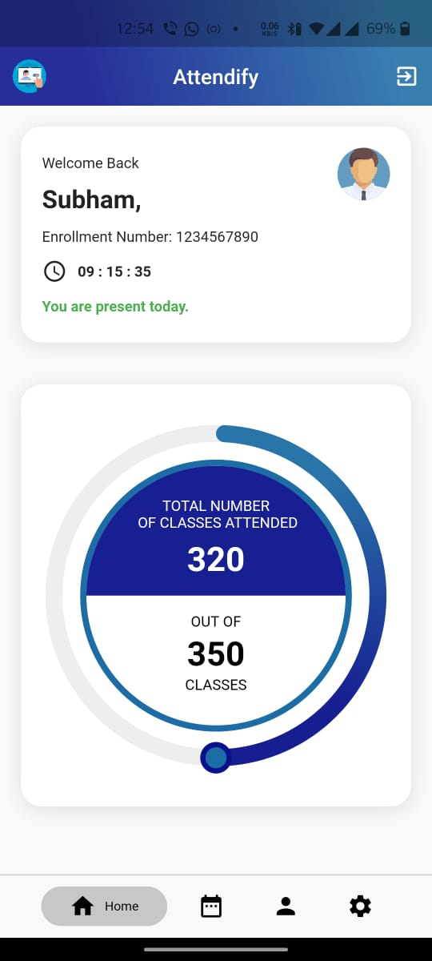
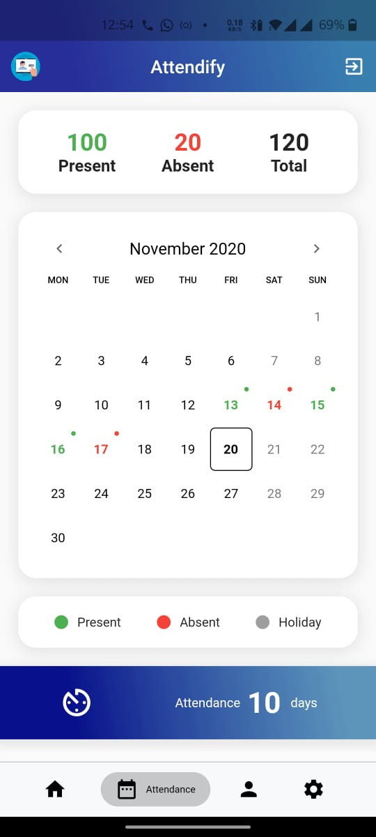
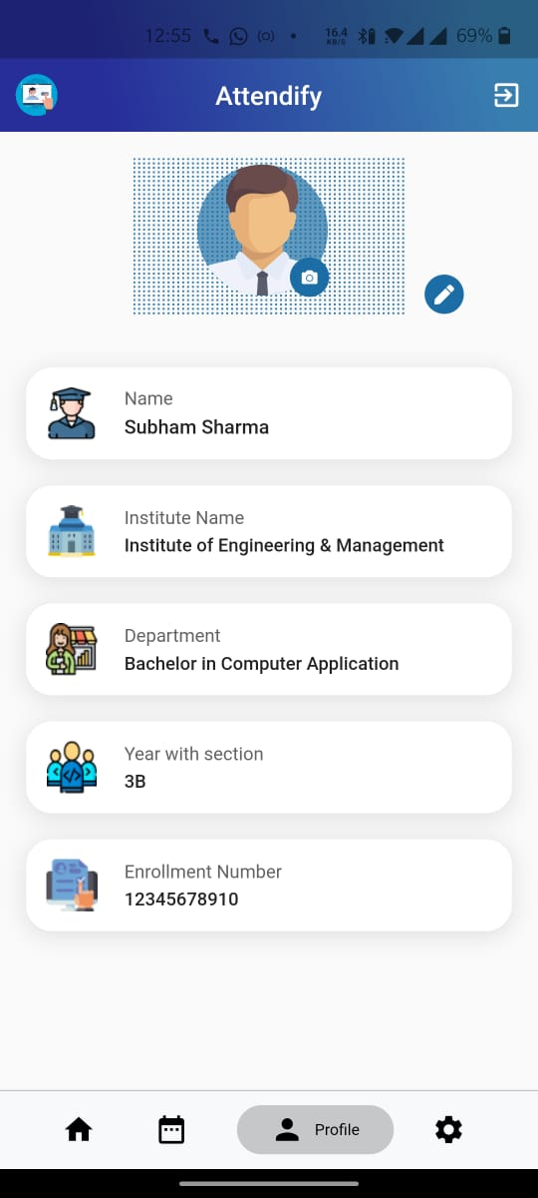
Our Mobile App
The Student Login Screen
The Student Dashboard
The Monthly Attendance Information Screen
The Student Profile screen

Slide 12
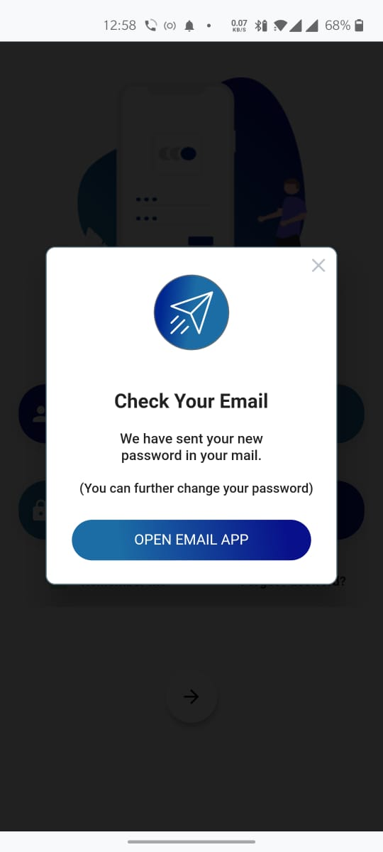
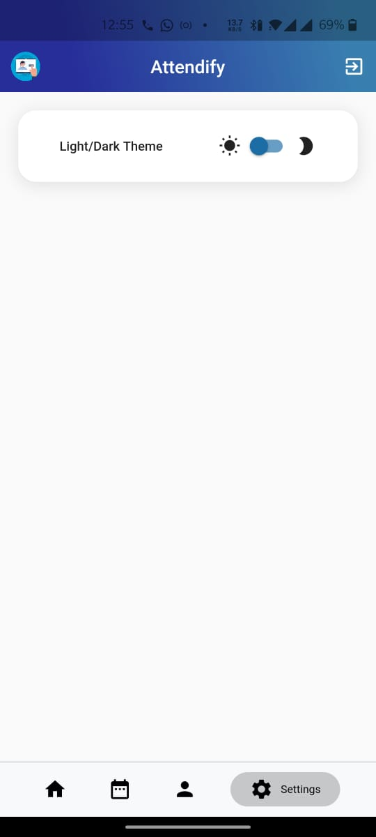
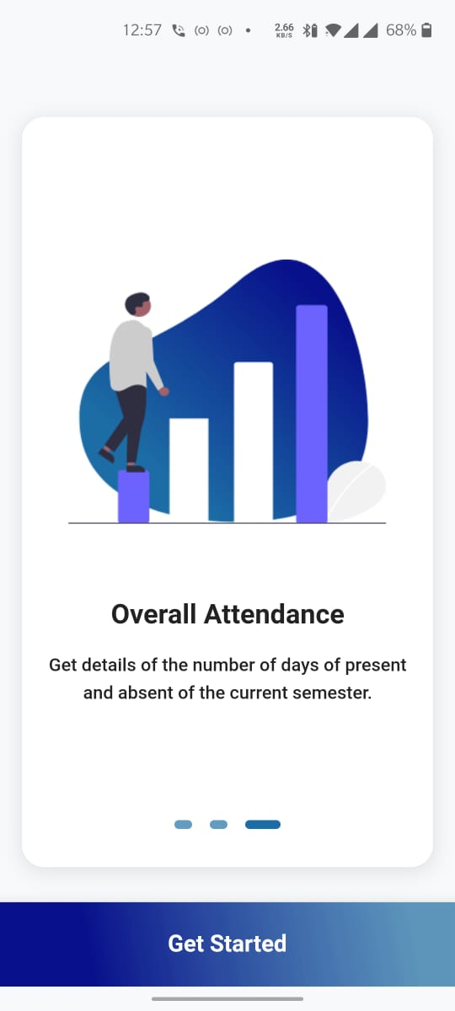
Our Mobile App
Change Password link sent to respective Email address
The Settings Screen
The Onboarding Screen

Slide 13
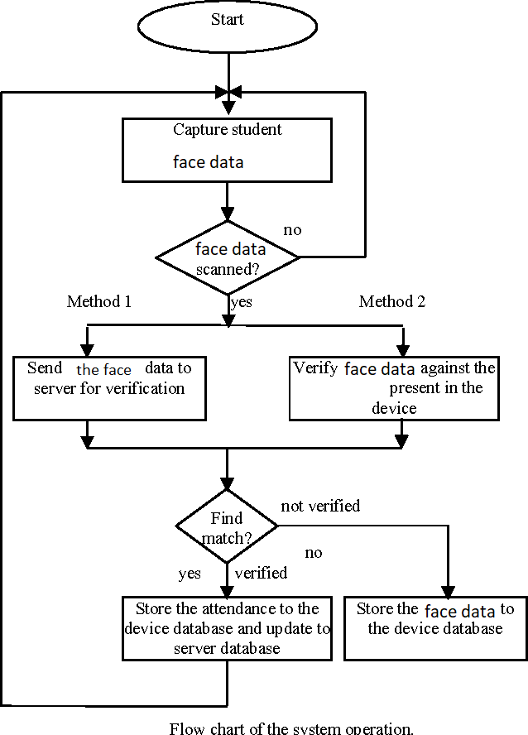
Process Control Diagram

Slide 14
Components Used
Attendify
Languages & Libraries
Python
OpenCV
PIL
Pandas
Shutil
Numpy
OS
Dlib for Facial Landmark Detection
Android App using Flutter
Tkinter GUI toolkit by Python for the desktop GUI
SQL for online database
Excel Sheet for offline Database
NODE JS

Slide 15

To create a real time automated attendance Management System
To make a contactless and hassle free attendance recoding system
To reduce the paper wasted recoding attendance.
Real time checking of the attendance.

Slide 16
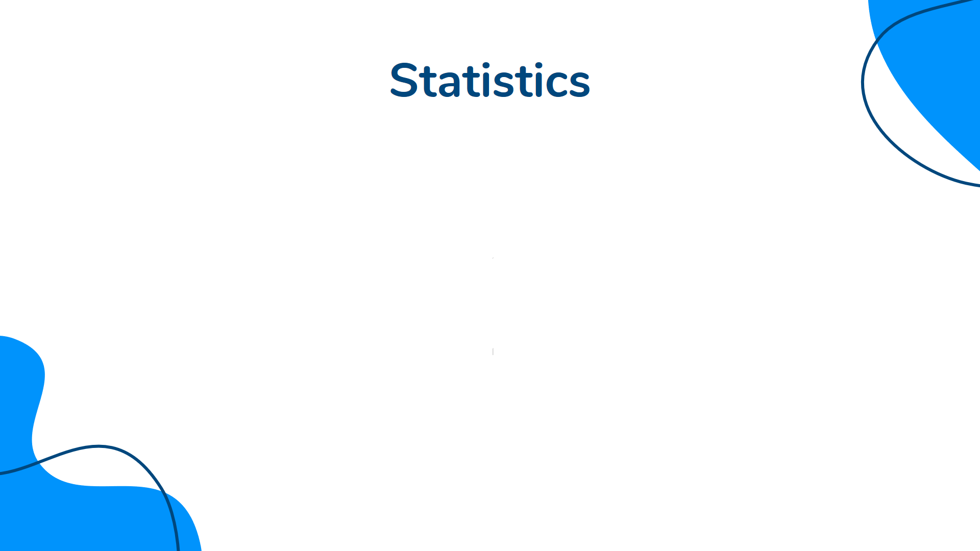
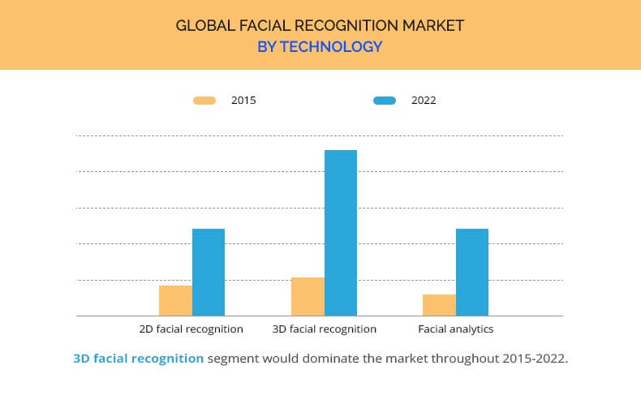
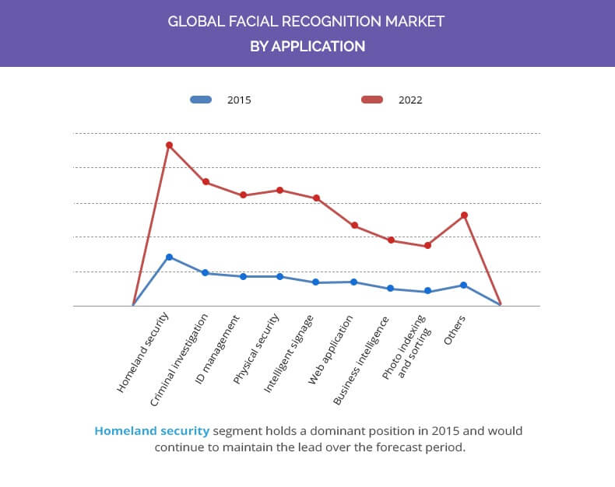
Notes:
https://www.alliedmarketresearch.com/facial-recognition-market
https://courses.cs.washington.edu/courses/cse576/08sp/projects/project3/artifact/seongjae/artifact/index.html

Slide 17


Our Success
95%
95% accuracy every time the face is scanned
9/10
9 of 10 users found our application easy to use and accurate.
99.99%
Once set up in on an online server, it will provide 99.99% uptime

Slide 18
Findings
Goals
Activities
Feedback
Create a automated Attendance Management System
We created it using Machine Learning, Deep Learning, Desktop App and an Android App
9/10 users who used our application found it useful and easy to use

Slide 19
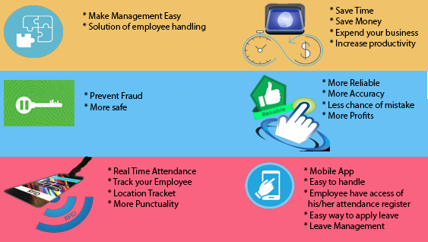
Cost of Application
We estimate the cost of manufacturing each unit is around ₹4500 per piece

Slide 20

We would like to thank our thank our mentor who guided us while making this project.

